Slide 1
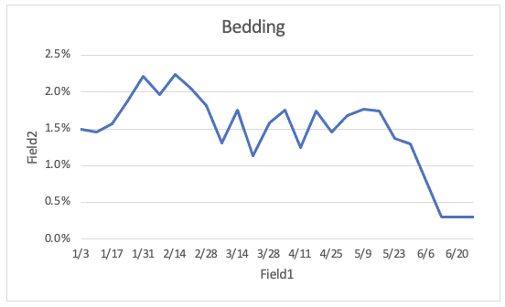
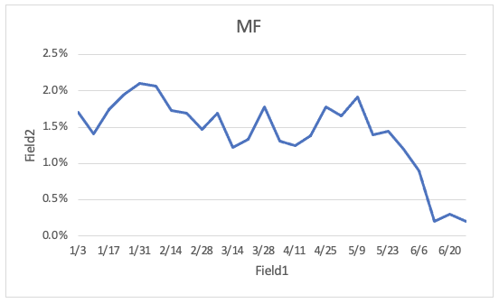
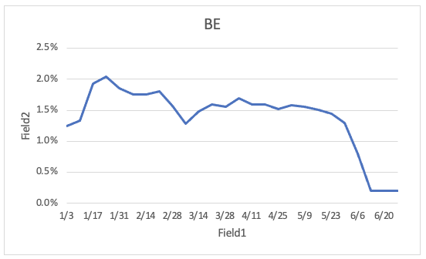
Recommendations: We should design and pursue initiatives that directly improve CVR to fix ROAS
Bedding
Mattresses & Foundations
Bedding Essentials
Subcategories selling bedding goods – Bedding (BDG), Mattresses & Foundations (MF), and Bedding Essentials (BE) – are driving a drop in CVR
CVR for BDG, MF, and BE has fallen from 1.3-1.8% pre-June to ~0.2-0.3% during June
Other, bath-related subcategories (e.g., Bathroom Accessories, Shower Curtains) have retained ~1.5% CVR
CVR decline within bedding subcategories is driven by both logistics issues in BDG and BE and pricing surges in MF
BDG and BE have seen out-of-stock rates double from ~8% to ~15-20% and expected shipment times double from ~7 days to ~15-16 days
MF has seen an average pricing surge of almost 50%, from ~$450-500 to ~$650-700
High MF prices may also be impacting BDG and BE sales, given customers purchasing new bed frames/mattresses may have also purchased bedding from Wayfair.

Slide 2
Next Steps:
We can test the impact of certain marketing strategies to win back conversion while Wayfair investigates and corrects
supply chain issues
• Offer customers discounts (through shipping cost) for longer shipment times
• Lower pricing/offer discount on MF if customer also makes purchases on BDG or BE

